Slide 1
Spring Framework

Slide 2
Overview
Spring is the most popular application development framework for enterprise Java. Millions of developers around the world use Spring Framework to create high performing, easily testable, reusable code.

Slide 3
October 2002
The first version was released
June 2003
The framework was first released under the Apache 2.0 license
March 2004
The first milestone release - 1.0
October 2006
Spring 2.0
November 2007
Spring 2.5
December 2009
Spring 3.0
December 2011
Spring 3.1
November 2022
Spring 6.1

Slide 4
BENEFITS
Spring enables developers to develop enterprise-class applications using POJOs.
Spring is organized in a modular fashion.
Spring does not reinvent the wheel instead, it truly makes use of some of the existing technologies.
Testing an application written with Spring is simple because environment-dependent code is moved into this framework.
Spring's web framework is a well-designed web MVC framework.
Lightweight IoC containers tend to be lightweight, especially when compared to EJB containers.
Spring provides a consistent transaction management.

Slide 5
Enterprise Java Beans
EJB stand for Enterprise Java Beans. It is a server side software component that summarizes business logic of an application. An EJB container provides the run time environment for web related software elements including computer reliability, Java Servlet Lifecycle (JSL) management, transaction procedure and other web services.

Slide 6
It specifies the bean format. It outlines a set of services provided by the container on which the bean runs. For this reason, developers need not to worry about services like security, transaction support, etc. An application server (such as JBoss, WebLogic, etc.) is required to run an EJB application. Although, the Spring framework can be used with any application server. Spring applications are locked into both Spring itself and the specific services you choose to integrate into the Spring framework.

Slide 7
Spring
Spring is an open-source, lightweight framework. It offers many features such as IOC, transaction management, JDBC exception handling, etc. It has a layered architecture that allows us to choose the necessary components while starting development. It also supports other frameworks such as Hibernate, JSF, EJB, etc. Spring framework forces the developers to emphasize the business requirements rather than the architectural details of the application.

Slide 8
The design of Spring Framework is such that it sits on the top of the application servers and service libraries. While in EJB 3.0, the framework is integrated into the application servers and the service integration code is encapsulated behind an interface. Thus, it can optimize the performance and developer experience by working at the application server level. For example, they can tie the JPA engine closely to JTA transaction management. Therefore, EJB is not perfect because some features are still missing like an injection of non-managed components like simple POJOs.

Slide 9
Key difference between both:
The key difference between EJB and Spring is that EJB is a specification of Java EE while Spring is a framework or an implementation. Another key difference is that Spring does not support propagation of transaction context across remote calls while EJB does the same.
EJB has been specially designed for transactional and component programming. It is used to develop the server-side application. While Spring provides the infrastructure configuration and lets the developer focus on business requirements.

Slide 10
Can Spring replace EJB?
Spring was developed as an alternative to EJB from its beginning. All the components of EJB are integrated into Spring. Hence, we can use Spring instead of EJB. Spring encourages good object-oriented design practice. The advantage of using Spring is that we can easily switch to other DI frameworks such as Guice.

Slide 11
Java Spring Framework is full of features and provides and helps to create Java-based scalable applications. Here, we are discussing some features. Although these are not limited as spring provides dozens of variety of projects such as Spring Data, Spring Cloud, Spring Boot, etc. The following are the Features of the Spring Framework.
Flexible
Productive
Fast
Secure
Supportive
Everywhere

Slide 12
Spring is Everywhere
Spring is one of the most popular frameworks worldwide. It is used for enterprise application development in Java. We can use it to create web services, web applications, cloud-based services, etc. It is used by world tech organizations like Google, Alibaba, Amazon, Oracle, etc. Java developers all over the world trust Spring’s libraries. It is used almost everywhere whether streaming TV, connection IoT, eCommerce applications, Banking, etc.

Slide 13
Spring is Flexible
Spring provides flexible third-party libraries and extensions that help developers to build applications. The Inversion of Control (IoC) and Dependency Injection (DI) are the main features of Spring that made it flexible for creating enterprise applications. Spring provides several tools that help developers to build secure, reactive, and cloud-based microservices for the web, even you can use it for complex streaming data flows for enterprise applications.

Slide 14
Spring is Productive
Spring is a productive framework no doubt and after adding the Spring Boot project Spring framework has transformed into a more productive framework. Spring Boot is combined with all the necessities and auto-configured settings. It has an embedded webserver to make microservices development faster. The most important is the integration of spring projects that help to create applications in a row. For example, to create an application it provides a framework, to connect databases it provides Spring Data, to work with Cloud, it provides Spring cloud and for security, it provides Spring security. So, what we need to do is just put them into our application based on the requirement and our application is ready.

Slide 15
Spring is Fast
The performance of the Spring framework is super due to its design and architecture. Spring foundation is focused on the performance that gives the application a fast startup at the starting point, stable execution, and fast shutdown. For better performance and efficiency, Spring projects support the reactive programming model. Spring provides Spring Initializer tool to start with application quickly. With Spring Boot that already equipped with the tools like embedded web server, auto-configured helps developers to build applications with ease. Adding of LiveReload in Spring DevTools removes the issue and need for a server restart.

Slide 16
Spring is Secure
Spring is secure by nature itself, along with the security provided by Java language too, but for more security purposes we can use Spring Security. Spring Security is one of the projects of Spring that is designed to handle the security of any Spring application. Since it is part of the Spring framework, hence it is easy to integrate with the application. Spring quickly handle and deal with security issues and handle them. It closely monitors third-party dependencies, and regular updates to keep our data and applications safe and secure.

Slide 17
Spring is Supportive
The Spring has a vast, global, enormous, and diverse community for all the developers worldwide. Spring provides supports for all no matter where you are residing and what level of knowledge you have. It helps for all ages and capabilities, from complete beginners to industry experts. Spring community provides a variety of resources like videos, guides, tutorials, meetups, support, or even formal training and certification.

Slide 18
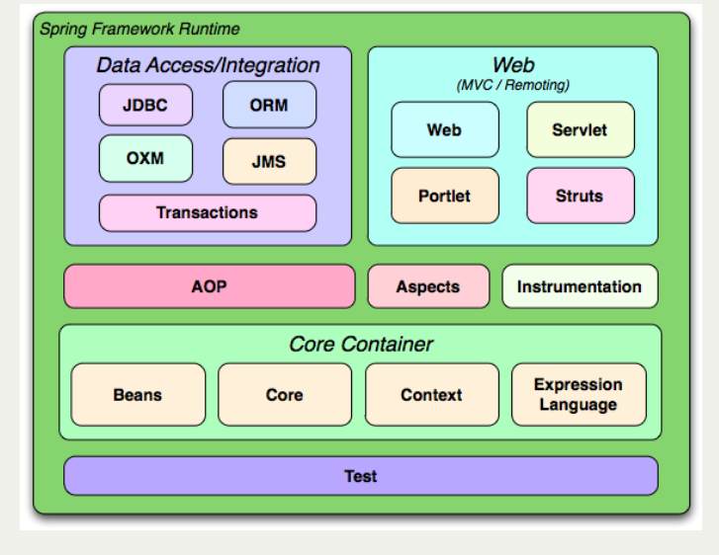
Spring Framework Architecture

Slide 19
Spring Modules
The Spring Framework is divided into several modules based on their services. These modules are:
Spring Core Container: It is the core module of the Spring that provides containers like BeanFactory and ApplicationContext.
Inversion of Control: It is also known as dependency injection and used to configure application components and lifecycle management of Java objects.
Aspect-Oriented Programming: This module enables implementing cross-cutting concerns inside the Spring framework such as transaction management, remote access, etc.
Data Access: It helps with working with database systems by using Java Database Connectivity (JDBC) and ORM (Object-Relational Mapping) tools.
Model View Controller: It is also known as the MVC model that helps to create web-based applications and RESTful Web services.
Authentication And Authorization: It is used to configure security processes within the framework by using the Spring Security (a sub-project of Spring).
Messaging: Spring uses a message listener object to convey the message by using JMS (Java Message Service) which is the improvement of JMS API.
Transaction Management: It consists of several transaction management APIs and coordinates transactions for Java objects.
Remote Management: It helps to configure Java objects for local or remote by using Java Management Extensions (JMX).
Testing: Testing module that helps in writing unit tests and integration tests.

Slide 20
IoC container: Refers to the core container that uses the DI or IoC pattern to implicitly provide an object reference in a class during runtime. This pattern acts as an alternative to the service locator pattern. The IoC container contains assembler code that handles the configuration management of application objects. The Spring framework provides two packages, namely org.springframework.beans and org.springframework.context which helps in providing the functionality of the IoC container.
Data access framework: Allows the developers to use persistence APIs, such as JDBC and Hibernate, for storing persistence data in database. It helps in solving various problems of the developer, such as how to interact with a database connection, how to make sure that the connection is closed, how to deal with exceptions, and how to implement transaction management It also enables the developers to easily write code to access the persistence data throughout the application.
Spring MVC framework: Allows you to build Web applications based on MVC architecture. All the requests made by a user first go through the controller and are then dispatched to different views, that is, to different JSP pages or Servlets. The form handling and form validating features of the Spring MVC framework can be easily integrated with all popular view technologies such as ISP, Jasper Report, FreeMarker, and Velocity.
Transaction management: Helps in handling transaction management of an application without affecting its code. This framework provides Java Transaction API (JTA) for global transactions managed by an application server and local transactions managed by using the JDBC Hibernate, Java Data Objects (JDO), or other data access APIs. It enables the developer to model a wide range of transactions on the basis of Spring’s declarative and programmatic transaction management.

Slide 21
Spring Web Service: Generates Web service endpoints and definitions based on Java classes, but it is difficult to manage them in an application. To solve this problem, Spring Web Service provides layered-based approaches that are separately managed by Extensible Markup Language (XML) parsing (the technique of reading and manipulating XML). Spring provides effective mapping for transmitting incoming XML message request to an object and the developer to easily distribute XML message (object) between two machines.
JDBC abstraction layer: Helps the users in handling errors in an easy and efficient manner. The JDBC programming code can be reduced when this abstraction layer is implemented in a Web application. This layer handles exceptions such as DriverNotFound. All SQLExceptions are translated into the DataAccessException class. Spring’s data access exception is not JDBC specific and hence Data Access Objects (DAO) are not bound to JDBC only.
Spring TestContext framework: Provides facilities of unit and integration testing for the Spring applications. Moreover, the Spring TestContext framework provides specific integration testing functionalities such as context management and caching DI of test fixtures, and transactional test management with default rollback semantics.

Slide 22
Step 1. First, you need to download some jar files for Spring Framework. So go to the following link to download the Spring commons-logging jar file along with Spring Framework. spring framework: https://repo.spring.io/release/org/sp... commons-logging JAR: https://jar-download.com/artifacts/co...
Step 2. Now open your Eclipse IDE and create a new project. Then click on the build path and import all downloaded jar files for the spring framework under classpath.

Slide 23
Spring Core Concepts
It is impossible to understand what is Spring Framework without understanding what is Dependency Injection and Inversion of Control. Dependency Injection also called as DI, is one of the types of Inversion of Control (IoC).
Inversion of Control - this is the principle of object-oriented programming, in which objects of the program do not depend on concrete implementations of other objects, but may have knowledge about their abstractions (interfaces) for later interaction.
Dependency Injection - Dependency Injection is the main functionality provided by Spring IOC(Inversion of Control). The Spring-Core module is responsible for injecting dependencies through either Constructor or Setter methods. The design principle of Inversion of Control emphasizes keeping the Java classes independent of each other and the container frees them from object creation and maintenance. These classes, managed by Spring, must adhere to the standard definition of Java-Bean. Dependency Injection in Spring also ensures loose-coupling between the classes.
Aspect oriented programming - a programming paradigm that allows you to distinguish cross-through (functional) functionality in application. These functions, which span multiple application nodes, are called cross-cutting concerns and these cross-cutting notes are separated from the immediate business logic of the application. In OOP, the key unit is the class, while in AOP, the key element is the aspect. DI helps to separate application classes into separate modules, and AOP helps to separate cross-cutting concerns from the objects they affect.

Slide 24
Environment Setup
Step 1: Install Java
Java is a programming language that is used by the Spring framework to create an application. So it is our first task to Install Java and set up its classpath on our computer. For more about Java Language, you can read our Java tutorial.
Step 2: Download and Install Eclipse
Eclipse is an IDE(Integrated Development Environment) that is used for software development. It provides a platform to build applications a single place. We can handle multiple tools and by using its controls.

Slide 25
Step 3: Download Spring JARs
To work with the Spring framework, we must have Spring JARs that are basically Java files that contain packages, classes, and interfaces to create the spring application.
There are two ways to have these JARs. Either download them from the Spring official site and put them into the Spring project or create a Maven project that will automatically download these JARs into your project.
If you want to download these JARs directly then visit the official repository of Spring by clicking here Download Spring JARs. Pick the latest JARs from there, extract them, and put them into the Spring project's lib folder.

Slide 26
Spring Maven Project
Step1: Create Maven Project
Open Eclipse and clike on File menu and then select New --> Maven Project
After selecting maven, it will open a window like below and will ask to select archetype. Here, we clicked on Checkbox and then press next button.
Step 2: Configure the Project
Set project name by providing group id and artifact id. Artifact id represents the project name, So give a meaning name for your project after that select packaging that specifies the plugin goals that are executed during each Maven build phase. After that press Finish button and your maven project is ready.

Slide 27
Spring IOC Container
Spring IoC Container is a core part of the Spring framework which is used to manage the application bean. It injects dependencies when a bean is created and manages the bean life cycle during execution.
The fundamental tasks of Spring IoC are:
Instantiating
Configuring, and
Assembling Bean

Slide 28
The IOC container gets configuration related information from the Spring configuration file. That can be either XML or Java files.
The container uses dependency injection (DI) to manage the components that make up an application.
Spring provides two types of IOC containers:
BeanFactory
Application Context

Slide 29
Spring BeanFactory Interface
It is an IoC container that is responsible for maintaining beans and their dependencies. It is basically an interface that provides basic functionalities.

Slide 30
Application Context
Spring IoC container is responsible for instantiating, wiring, configuring, and managing the entire life cycle of objects. BeanFactory and ApplicationContext represent the Spring IoC Containers. ApplicationContext is the sub-interface of BeanFactory. BeanFactory provides basic functionalities and is recommended to use for lightweight applications like mobile and applets. ApplicationContext provides basic features in addition to enterprise-specific functionalities which are as follows:
Publishing events to registered listeners by resolving property files.
Methods for accessing application components.
Supports Internationalization.
Loading File resources in a generic fashion.

Slide 31
Note: It is because of these additional features, developers prefer to use ApplicationContext over BeanFactory.

Slide 32
ApplicationContext Implementation Classes
There are different types of Application containers provided by Spring for different requirements as listed below which later onwards are described alongside with declaration, at lastly providing an example to get through the implementation part with the pictorial aids. Containers are as follows:
AnnotationConfigApplicationContext container
AnnotationConfigWebApplicationContext
XmlWebApplicationContext

Slide 33
Difference Between BeanFactory and ApplicationContext
Both the interfaces(BeansFactory and ApplicationsContext) acts as the IoC container. The BeanFactory interface is a base interface and provides all the basic functionalities to create and run the IoC container while the ApplicationContext interface is a subinterface of the BeanFactory interface that adds some extra functionalities like simple integration with Spring's AOP, message resource handling (for I18N), application layer specific context, etc. So, we can use ApplicationContext for better features.

Slide 34
How to Configure the IoC Container?
<beans xmlns="http://www.springframework.org/schema/beans"
xmlns:xsi="http://www.w3.org/2001/XMLSchema-instance"
xsi:schemaLocation="http://www.springframework.org/schema/beans
https://www.springframework.org/schema/beans/spring-beans.xsd">
<bean id="..." class="...">
<!-- collaborators and configuration for this bean go here -->
</bean>
<!-- more bean definitions go here -->
</beans>

Slide 35
There are mainly three ways by which we can configure our IoC container.
XML Based
Annotation Based
Java-Based

Slide 36
Spring Bean
Bean is an object in Spring that is managed by the Spring IoC Container. Spring creates bean with the configuration metadata that we have supplied in the <bean> tag of the XML file. We provide metadata to the IoC container either by using the XML file or by Java annotations.
During metadata configuration, we provide bean definitions with some optional attributes such as:
The fully qualified name of Bean class name. such as com.FirstJava.demo.HelloWorldService
Bean behavior such as Bean scope, lifecycle callback, etc.
Bean dependencies (references to other beans) that are needed for the bean.

Slide 37
The <bean> Tag Structure
<bean id="demoBean" class="com.examples.DemoBean" />
The id attribute sets a unique id for the class specified by the class attribute.

Slide 38
Things tto remember
1. Naming Bean
To set the name of a bean in XML-based configuration, we use the id, name attributes, or both. The id attribute lets us specify exactly one id.
While setting bean names we are required to follow the naming conventions it means bean names start with a lowercase letter and are camel-cased.
<bean id="..." class="...">
<!-- Configuration for this bean go here -->
</bean>

Slide 39
Lazy Initialization
By default, ApplicationContext implementations eagerly create and configure all singleton beans as part of the initialization process.
A lazy-initialized bean tells the IoC container to create a bean instance when it is first requested, rather than at startup.
<bean id = "..." class = "..." lazy-init = "true">
<!-- Configuration for this bean go here -->
</bean>

Slide 40
Init Method
This attribute is used to specify the method that executes at bean initialization time. Syntax of the bean tag and attribute is given below.
<bean id = "..." class = "..." init-method = "...">
<!-- Configuration for this bean go here -->
</bean>

Slide 41
Destruction Method
This attribute is used to specify the method that executes at bean destroy time. Syntax of the bean tag and attribute is given below.
<bean id = "..." class = "..." destroy-method = "...">
<!-- Configuration for this bean go here -->
</bean>

Slide 42
Spring Bean LifeCycle
The Spring Bean lifecycle involves several steps including bean initialization and bean destroy. These steps are managed by the Spring IOC and it lets us perform custom initializing and end up tasks.
In Spring, if we want to perform some tasks at the time of bean initialization and before destroying the bean object then we can use Spring's predefined interfaces InitializingBean and DisposableBean. These interfaces provide methods that can be used to perform tasks before and after creating the bean. Java provides annotations too to work with the Bean lifecycle.
There are two ways to perform these tasks:
Interfaces
Annotations

Slide 43
The Spring InitializingBean interface provides a method afterPropertiesSet() that can be used to perform initializing tasks while the DisposableBean interface provides a method destroy() to perform cleaning resources before destroying bean objects.

Slide 44
Bean Lifecycle using Interfaces

Slide 45
Spring Bean Scope
Bean Scope refers to the lifecycle of a bean, visibility of a bean, how long does the bean live, how many instances are created, how is the bean shared?
Bean's default scope is a singleton. The spring container will create a single instance of the bean. It is cached in memory. All requests for the bean will return a shared reference of the same bean.
Spring provides @Scope annotation to mark a bean scope.

Slide 46
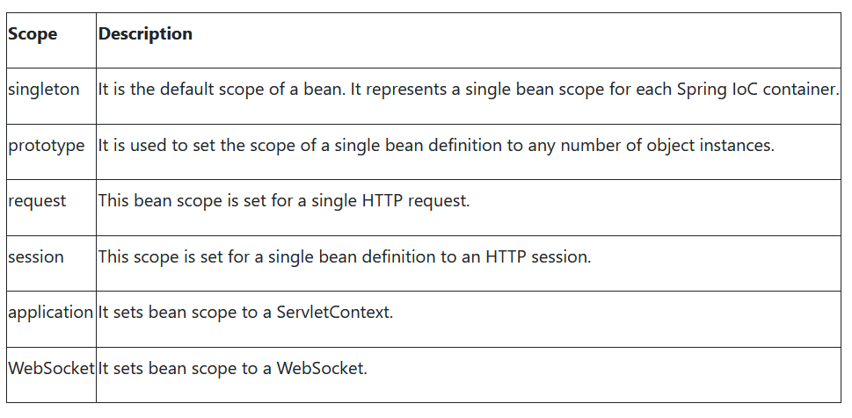
Spring Bean Scope
The following are the types of bean scope used in the Spring application.

Slide 47
Bean Singleton Scope (Default Scope)

Slide 48
Bean Scope Prototype
This is another type of bean scope and in this case, two bean objects of the same class are not equal.

Slide 49
Constructor-Based Dependency Injection
we are using the constructor-based dependency injection technique to inject values through the constructor but before moving further let's first understand what is Dependency Injection(DI).Dependency Injection is a technique by which an object defines its dependencies. The IOC container then injects these dependencies during bean creation. This process is fundamentally the inverse and known as Inversion of Control as well. Dependency Injection makes our code loosely coupled. It is classified into two major categories Constructor-based dependency injection and Setter-based dependency injection.

Slide 50
Using xml based configuration
<bean id="accountant"
class="com.studytonight.community.Accountant" />
<bean id="manager" class="Manager">//complete path of manager class
<constructor-arg>
<ref bean="accountant" />
</constructor-arg>
</bean>

Slide 51
Setter Dependency Injection

Slide 52
Using XML based configuration
<bean id="accountant"
class="com.studytonight.community.Accountant" />
<bean id="manager" class="com.studytonight.community.Manager">
<property name="accountant">
<ref bean="accountant" />
</property>
</bean>

Slide 53
Spring Autowiring
Autowiring is a technique used in Spring to enable automatic dependency injection. By using it Spring container can autowire relationships between collaborating beans. It is known as Spring Autowiring.
Spring provides @Autowired annotation that enables you to inject the object dependency implicitly. It internally uses setter or constructor injection.

Slide 54
Note: We can not use @Autowired annotation to inject primitive and string values. It works with reference only.

Slide 55
Enable AutoWiring in Spring
The Spring framework enables automatic dependency injection. In other words, by declaring all the bean dependencies in a Spring configuration file, the Spring container can autowire relationships between collaborating beans. This is called Spring bean autowiring.
In a Java-based configuration, we can enable it by using the @componentScan annotation.

Slide 56
@Configuration
@ComponentScan("com.bacepackage”)
public class AppConfig{
}
in case of XML configuration, we can use <context:annotation-config> tag inside the applicationcontext file.

Slide 57
Autowiring can be used with fields, methods, and constructors as well. Let's see some examples
After enabling annotation injection, we can use autowiring on properties, setters, and constructors.

Slide 58
eg-Field Autowiring
@Service
@Component
public class UserServices {
@Autowired
private SessionFactory sessionFactory;
public void setSessionFactory(SessionFactory sessionFactory) {
this.sessionFactory = sessionFactory;
}
}

Slide 59
Eg-Method Autowiring
@Component
public class FictionWriter implements Writer {
private Award award;
@Autowired
public void awardInstance(Award award) {
this.award = award;
}
}

Slide 60
Eg-Constructor Autowiring
@Component
public class TechnicalWriter implements Writer{
private Award award;
@Autowired
public TechnicalWriter(@Qualifier("pulitzerAward") Award award) {
this.award = award;
}

Slide 61
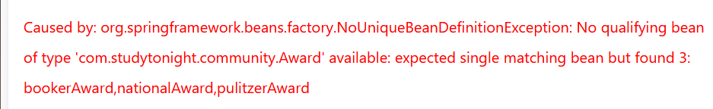
@Qualifier Annotation
The @Qualifier annotation in Spring is used to differentiate a bean among the same type of bean objects.
If we have more than one bean of the same type and want to wire only one of them then use the @Qualifier annotation along with @Autowired to specify which exact bean will be wired.
If we don't use this annotation in the given project then we get an error like:

